Slide 1
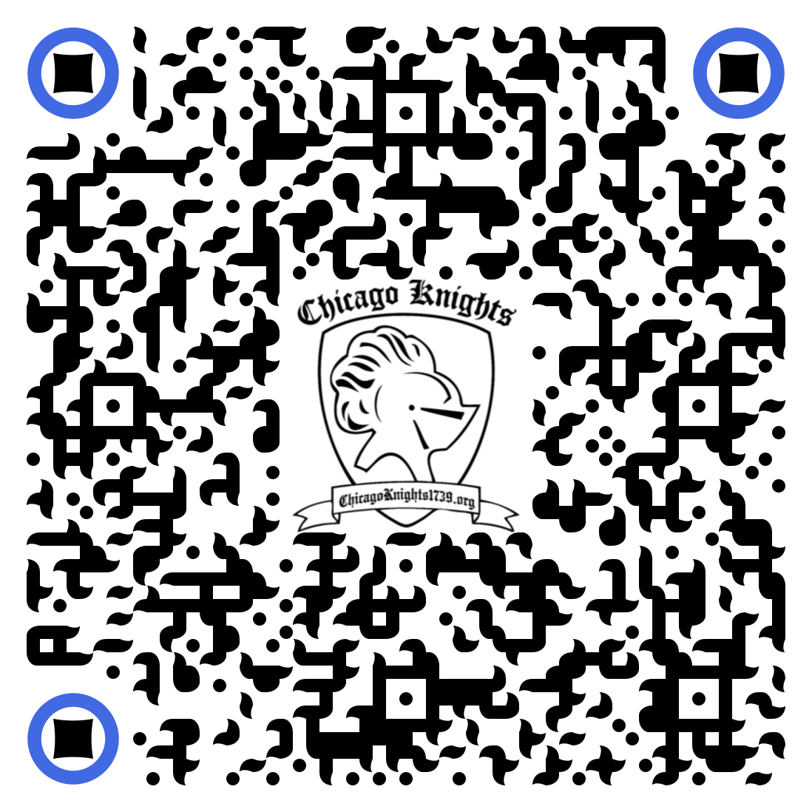
Switching to Python for FRC
JT Moore Chicago Knights 1739

Slide 2

JT
Digital Forensics/Incident Response @ Motorola Solutions
Lead Programming mentor CK 1739
18 Years of FIRST
Breaker of things (sometimes on purpose)
Googles “How to write for-loop”

Slide 3
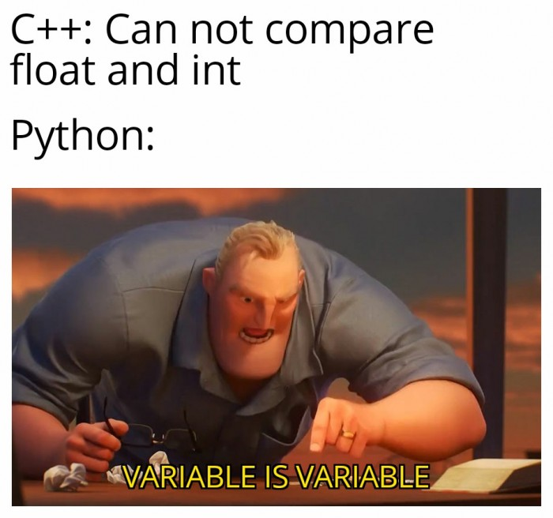
Why did we use Python?
Indoctrinate them early (FLL)
Mostly Rookie Team
Distributed Team, Distributed Code
Useful outside of robots
Fullstack sign-in system
Python’s just better (fail fast)

Slide 4
Switching from LabVIEW to robotpy

Slide 5
The Good
Practice with Romi robots
Integrations with OpenCV
Straight forward syntax
Write code for your sub processors in one language

Slide 6
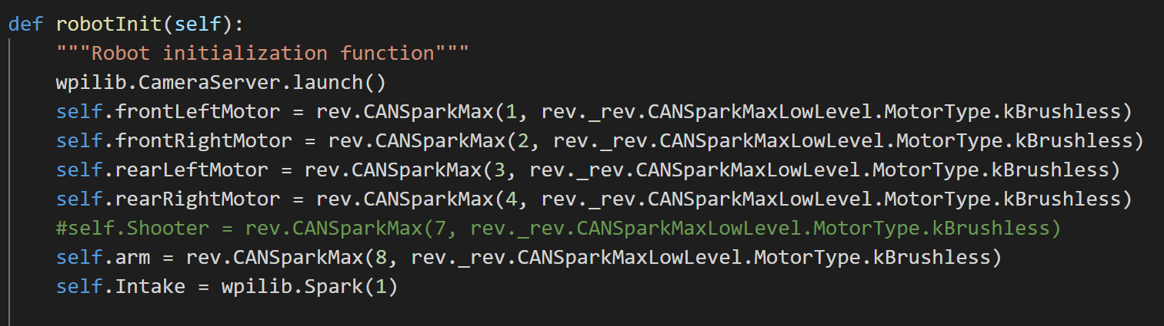
The Bad
Documentation and libraries are the Wild Wild West
Smart Dashboard is WIP

Slide 7
The Unexpected
Better Battery performance
No machine code = you can recover code from roboRIO
Imagination is your limitation
Robot sim is kinda nice

Slide 8

Are there any training materials?
A Phenomenal Presentation can be found here:
Getting Started with RobotPy
Regular Challenges can be found here:
Github Link

Slide 9
Thank you!
Q&A

